Slide 1

SUSE at Home SE – Hands on
M5stickC Plus and the ENVII sensor

Slide 2
Agenda
Updates
Tools
Labs
Install Mosquitto – MQTT
Install Node Red
m5Stick
Update firmware
Upload code
Deploy Node Red Dashboard

Slide 3

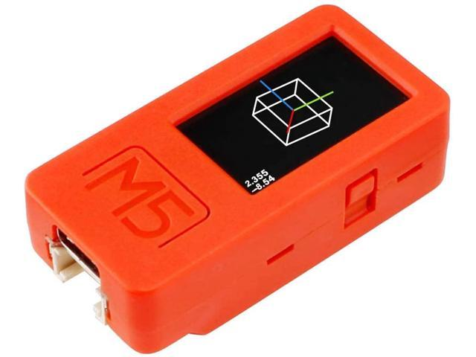

Today’s Goal
Deploy Apps on base Environment
Mosquitto - MQTT
Node Red -Dashboard
M5stack
ENVII Sensor

Slide 4
updates
New Project Home
https://github.com/SUSE/suse-at-home
Updated most labs
Booting SLE from USB on Raspberry Pi
Rancher on Raspberry Pi
Node Red
Mosquitto
M5stick
SLE Micro – Coming very soon

Slide 5
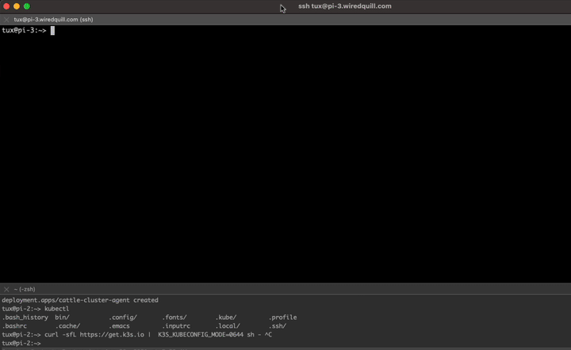
Tools
https://apps.apple.com/us/app/copy-em-clipboard-manager/id876540291?mt=12

Slide 6
Tools
MQTT Explorer
http://mqtt-explorer.com

Slide 7
Tools
Supercharge Kubernetes
https://agrimprasad.com/post/supercharge-kubernetes-setup/

Slide 8
Labs
Install Mosquitto – MQTT
Install Node Red
m5Stick
Update firmware
Upload code
Deploy Node Red Dashboard

